Slide 1
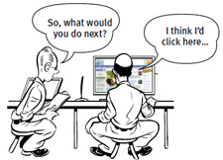
Usability Testing

Slide 2
Content for Today
Usability testing
Planning
Recruiting participants
Conducting usability testing
Data analysis
Result report
https://www.youtube.com/watch?v=BrVnBdW6_rE

Slide 3
Usability
Usability is a quality attribute that assesses how easy user interfaces are to use.
How easy will the software be for a typical user to understand, learn, and operate
e.g., “user-friendliness”

Slide 4
ISO Definition (9241-11) for Usability:
“...the extent to which a product can be used by specified users to achieve specified goals with effectiveness, efficiency and satisfaction in a specified context of use.”

Slide 5
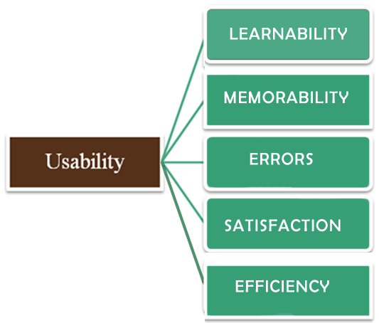
Usability is defined by 5 quality components
http://www.chrisdasie.com/myposts/5-components-of-usability
https://www.nngroup.com/articles/usability-101-introduction-to-usability/
Notes:
5

Slide 6
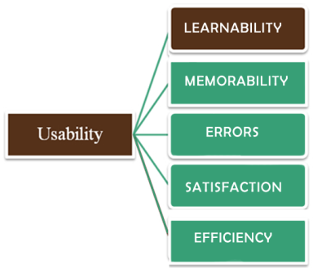
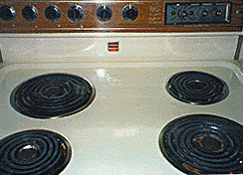
Learnability: How easy is it for users to accomplish basic tasks the first time they encounter the design?

Slide 7
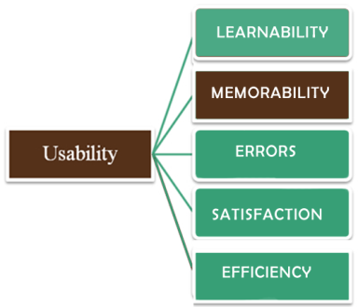
Memorability: When users return to the design after a period of not using it, how easily can they reestablish proficiency?

Slide 8
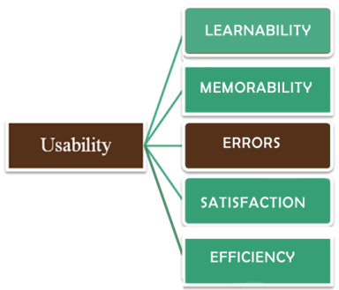
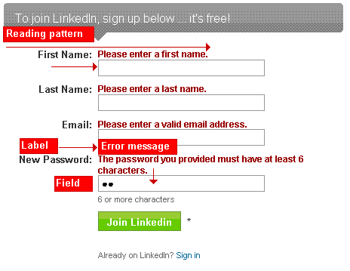
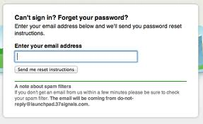
Errors: How many errors do users make, how severe are these errors, and how easily can they recover from the errors?

Slide 9
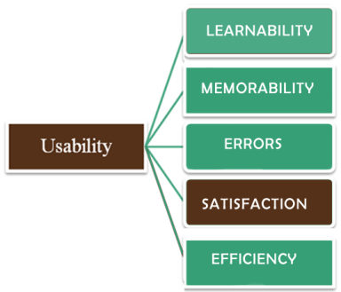

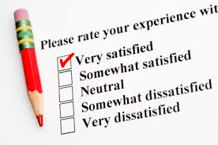
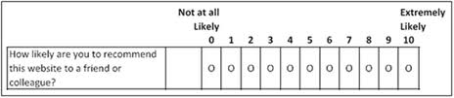
Satisfaction: How pleasant is it to use the design?

Slide 10
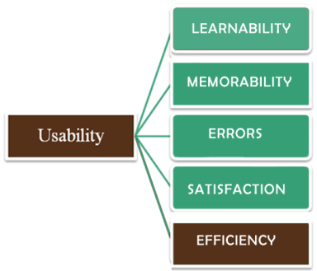
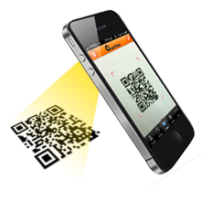
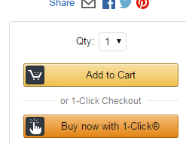
Efficiency: Once users have learned the design, how quickly can they perform tasks?

Slide 11
_{Usability Testing}

Slide 12
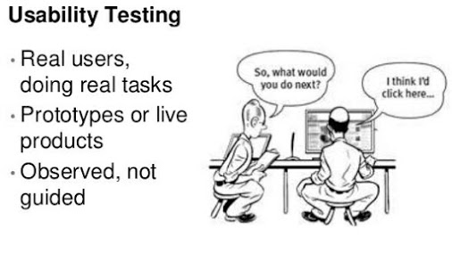
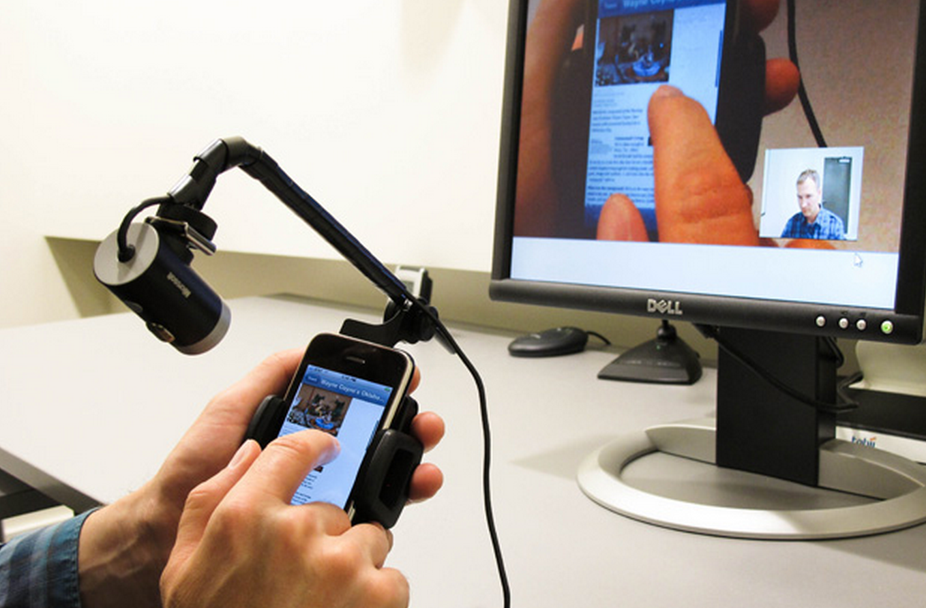
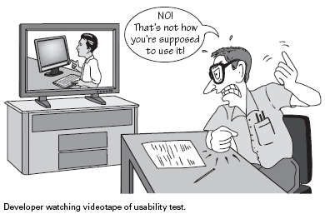
What is Usability Testing?

Slide 13
Examples of Usability Testing
Check here to see how it was tested. The questions are in the upper-right corner of the screen
https://www.youtube.com/watch?v=m9D1suUiZjo

Slide 14
Question for you
What kind of preparation you need to do before conducting the usability testing with users?

Slide 15
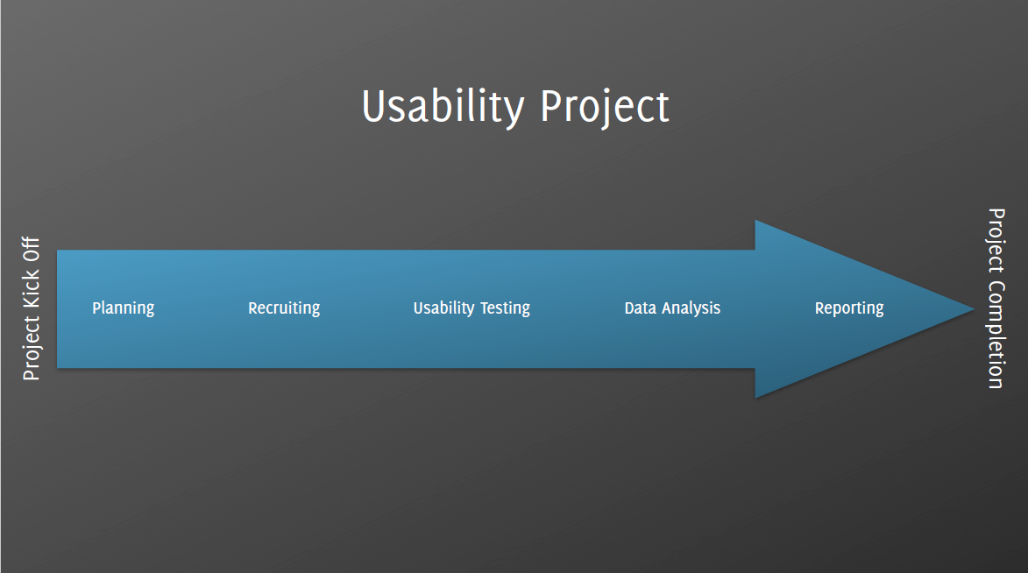

Slide 16
Planning a Usability Test
Scope: Indicate what you are testing:
Specify how much of the product the test will cover (e.g. the prototype as of a specific date; the navigation; navigation and content).
Purpose: Identify the concerns, questions, and goals.
These can be quite broad
for example, "Can users navigate to important information from the prototype's home page?"
They can be quite specific
for example, "Will users easily find the search box in its present location?"
https://www.usability.gov/how-to-and-tools/methods/planning-usability-testing.html

Slide 17
Planning a Usability Test
Schedule & Location: Indicate when and where you will do the test.
Sessions: You will want to describe the sessions, the length of the sessions (typically one hour to 90 minutes).
Equipment: Indicate the type of equipment you will be using in the test; desktop, laptop, mobile phone.
Participants: Indicate the number and types of participants to be tested.

Slide 18
Planning a Usability Test
Tasks/Scenarios: Indicate the number and types of tasks included in testing.
Metrics:
Quantitative metrics: Indicate the quantitative data you will be measuring in your test (e.g., successful completion rates, error rates, time on task).
Subjective metrics:
E.g., The questions you are going to ask the participants prior to the sessions (e.g., background questionnaire),
after each task scenario is completed (ease and satisfaction questions about the task),
and overall ease, satisfaction and likelihood to use/recommend questions when the sessions is completed.
Notes:
How about reggienet?

Slide 19
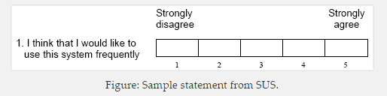
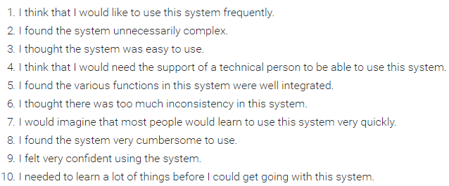
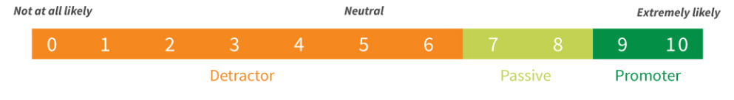
Some Usability Questionnaires
Post-Study Usability Questionnaire (PSSUQ)
System Usability Scale （SUS）
USE Questionnaire: Usefulness, Satisfaction, and Ease of use
Net promoter score (NPS)
How likely is it that you would recommend [brand] to a friend or colleague?
Notes:
Net promoter score (NPS)
https://chaione.com/blog/ux-research-standardizing-usability-questionnaires/
https://www.netpromoter.com/know/

Slide 20
Planning a Usability Test
Roles: Include a list of the staff who will participate in the usability testing and what role each will play.
The usability specialist should be the facilitator of the sessions.
The usability team may also provide the primary note-taker.
Other team members should be expected to participate as observers and, perhaps, as note-takers.

Slide 22
Recruit Participants
Representative
It is vital to recruit participants who are similar to your site users for your usability testing.
Depending on the site or product, you may have multiple potential users groups.
E.g., Reggienet
Students
Professors
TAs
https://www.usability.gov/how-to-and-tools/methods/recruiting-usability-test-participants.html

Slide 23
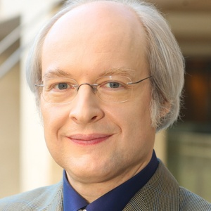
How Many Participants are Enough?
Nielsen outlines the number of participants that you need based on a number of case studies:
Usability Tests: test 5 users lets you find almost as many usability problems as you'd find using many more test participants.
Quantitative studies (aiming at statistics, not insights): test at least 20 users to get statistically significant numbers;
Card sorting: test at least 15 users.
Eye tracking: test 39 users if you want stable heat maps.
https://www.nngroup.com/articles/how-many-test-users/

Slide 24
Recruit Participants
Participant screening
Participant screeners are composed of questions that will help those recruiting for your test to rule individuals in or out of contention.
Age
Expereince
Compensating a participant
Cash, gift card, gifts
Extra credits

Slide 26
Think Aloud
This is described as “eavesdropping on someone’s thinking”. Thus, to say someone’s thought so that other people can hear them.

Slide 27
Moderating Techniques
Concurrent Think Aloud (CTA) is used to understand participants’ thoughts as they interact with a product by having them think aloud while they work.
In Retrospective Think Aloud (RTA), the moderator asks participants to retrace their steps when the session is complete. Often participants watch a video replay of their actions, which may or may not contain eye-gaze patterns.
Concurrent Probing (CP) requires that as participants work on tasks—when they say something interesting or do something unique, the researcher asks follow-up questions.
Retrospective Probing (RP) requires waiting until the session is complete and then asking questions about the participant’s thoughts and actions.

Slide 28
Question for you
What could be the pros and cons of the Concurrent and Retrospective techniques?

Slide 29
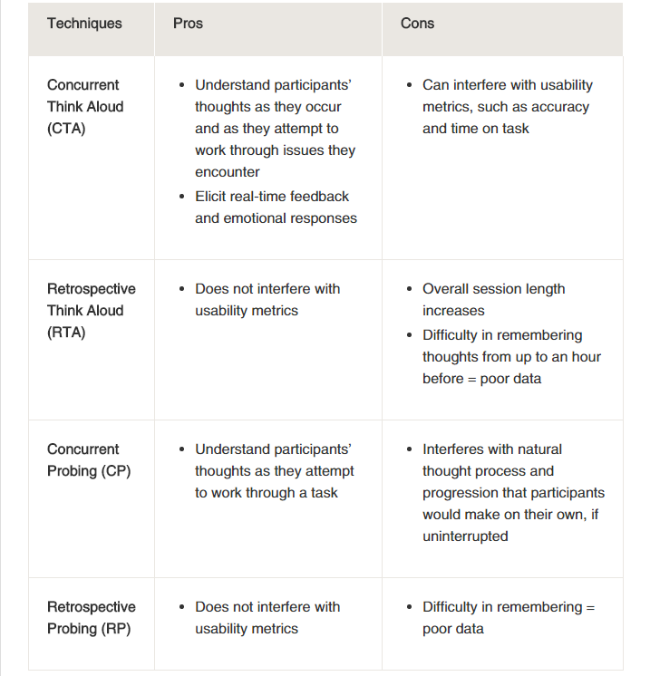

Slide 30
Question for you
Before we start the real test, what should we do to make sure everything is working appropriately?
For example,
questions are clear
test is not too long or too short
recording devices are working appropriately
The answer is on the next page

Slide 31
Pilot Testing
Prior to conducting a usability test, make sure you have all of your materials, consents and documentation prepared and checked.
It is important to pilot test equipment and materials with volunteer participants.
The pilot test allows you to:
Test the equipment
Provides practice for the facilitator and note-takers
Get a good sense whether your questions and scenarios are clear to the participant
Make any last minute adjustments

Slide 32
Example of Usability Testing Session
The facilitator will welcome the participant and explain the test session.
The facilitator asks any pre-test or demographic questions.
The facilitator explains thinking aloud and asks if the participant has any additional questions. The facilitator explains where to start.
The participant reads the task scenario aloud and begins working on the scenario while they think aloud.
The facilitator ask the participant to sign the consent form.

Slide 33
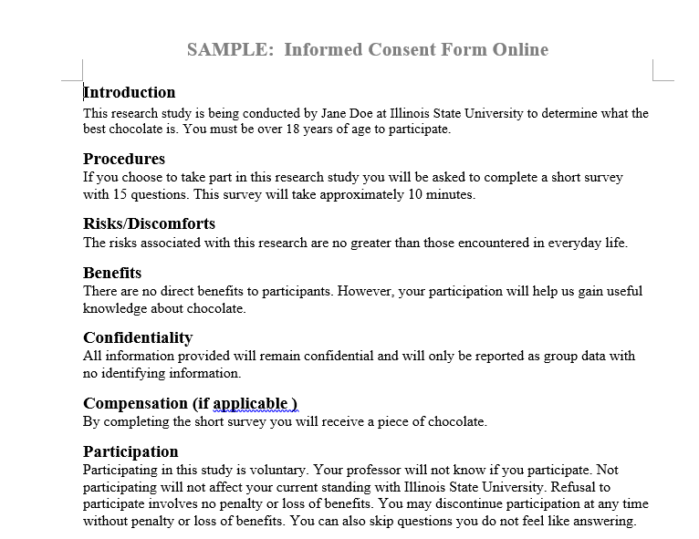
Consent Form Example

Slide 34
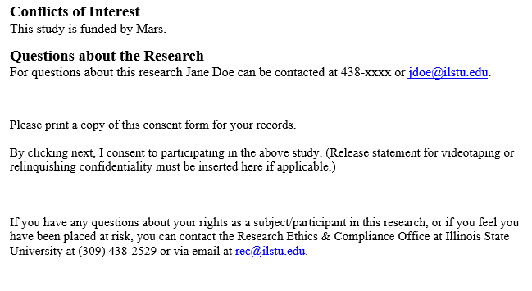

Slide 35
Example of Usability Testing Session
The note-takers take notes of the participant’s behaviors, comments, errors and completion (success or failure) on each task.
The session continues until all task scenarios are completed or time allotted has elapsed.
The facilitator either asks the end-of session subjective questions, thanks the participant, gives the participant the agreed-on incentive, and escorts them from the testing environment.

Slide 36
Best Practices
Treat participants with respect and make them feel comfortable.
Remember that you are testing the site not the users. Help them understand that they are helping us test the prototype or Web site.
Remain neutral – you are there to listen and watch. If the participant asks a question, reply with “What do you think?” or “I am interested in what you would do.”

Slide 37
Best Practices
Do not jump in and help participants immediately and do not lead the participant. If the participant gives up and asks for help, you must decide whether to end the scenario, give a hint, or give more substantial help.
The team should decide how much of a hint you will give and how long you will allow the participants to work on a scenario when they are clearly going down an unproductive path.

Slide 38
Best Practices
Take good notes. Note-takers should capture what the participant did in as much detail as possible as well as what they say (in their words).
Measure both performance and subjective (preference) metrics.
People's performance and preference do not always match. Often users will perform poorly but their subjective ratings are very high.
Performance measures include: success, time, errors, etc.
Subjective measures include: user's self reported satisfaction and comfort ratings.
Notes:
The better the notes are that are taken during the session, the easier the analysis will be.

Slide 40
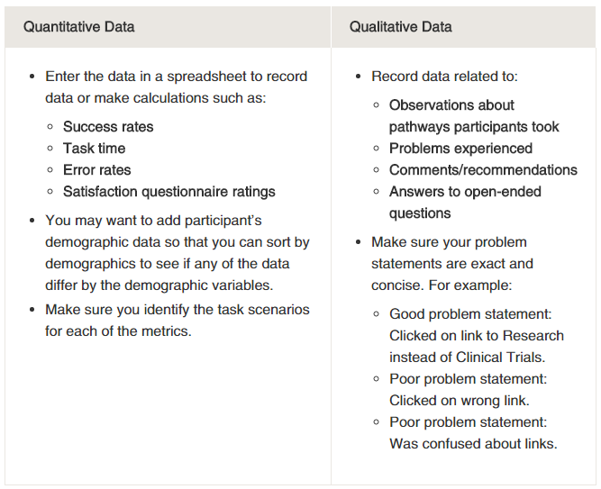

Slide 42
Writing the Usability Test Report
In general, your report should include a background summary, your methodology, test results, findings and recommendations.
Background Summary: Include
a brief summary including what you tested (website or web application),
where and when the test was held,
equipment information,
what you did during the test (include all testing materials as an appendix),
the testing team, and
a brief description of the problems encountered as well as what worked well.

Slide 43
Writing the Usability Test Report
Methodology: Include the test methodology so that others can recreate the test.
Explain how you conducted the test by describing
the test sessions,
the type of interface tested,
metrics collected, and
an overview of task scenarios.
Describe the participants and provide summary tables of the background/demographic questionnaire responses (e.g., age, professions, internet usage, site visited, etc.).
Provide brief summaries of the demographic data, but do not include the full names of the participants

Slide 44
Writing the Usability Test Report
Test Results:
For metrics,
Include an analysis of what the facilitator and data loggers recorded.
Describe the tasks that had the highest and lowest completion rates.
Provide a summary of the successful task completion rates by participants, and average success rate by task.

Slide 45
Writing the Usability Test Report
Findings and Recommendations:
A list of findings and recommendations
Keep in mind: Although most usability test reports focus on problems, it is also useful to report positive findings. What is working well must be maintained through further development.
Implementation
Designers may not be able to implement all the recommendations
develop priorities to fix the most global and serious problems.

Slide 46
Summary
Recruiting participants
Conducting usability testing
Pilot study
Consent form
Demographic questionnaire
Tasks
Post-study questionnaire/interview
Data analysis
Result report
Planning
Scope
Purpose
Schedule & Location
Sessions
Equipment
Participants
Tasks/Scenarios
Metrics

